Slide 1


CORONAVIRUS
HEALTH AND SAFETY
GUIDE

Slide 2

STOP THE SPREAD
Follow these simple steps to prevent the spread of the virus and protect you, your family, colleagues and anyone nearby!

Slide 3

What is Coronavirus (COVID-19)?
Coronavirus is a contagious viral strain that
can be passed from one person to another, via:
Direct contact (within 2m/6ft)
Respiratory droplets - sneezing, coughing, talking
Touching a surface infected with the virus

Slide 4

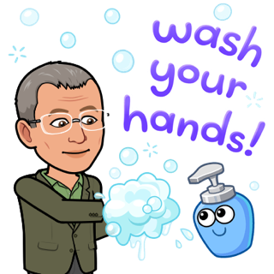

HANDS
Wash your hands for at least 60 seconds with soap. If no soap is available use a hand sanitizer with at least 60% alcohol.

Slide 5

FACE
Avoid touching your eyes, nose, and mouth as they’re the most common entry points of the virus

Slide 6



DISINFECT
Clean your work surfaces (desk, conference table, lunch area) using spray or disinfectant wipes.

Slide 7


AVOID CONTACT
Wash hands after contact with frequently touched objects, such as doorknobs, light switches, computers, copiers etc

Slide 8

SOCIAL DISTANCE
Remain at least six feet apart to the greatest extent possible, both inside and outside workplace.

Slide 9

MASK
Employees must wear a face covering while indoors at the workplace

Slide 10


SELF CARE
You've got a better shot at fighting the virus if you have a healthy immune system:
sleep, eat nutritious food, exercise and reduce stress.

Slide 11

STAY HOME IF FEELING ILL
Symptoms range from those of the flu to a mild cold, including:
Fever
Cough
Shortness of breath
Breathing difficulties

Slide 12

AWARENESS IS THE KEY TO PREVENTION
If you experience any of the symptoms, Do Not Panic!
Call your local emergency health service.
Massachusetts Department of Public Health
https://www.mass.gov/orgs/department-of-public-health
Phone (617) 624-6000
Town of Dighton Board of Health
Phone (774) 872-0943

Slide 13


We will get through this, Together!

